Slide 1
Wiresharking DNS
Rocky K.C. Chang
March 1, 2023

Slide 2
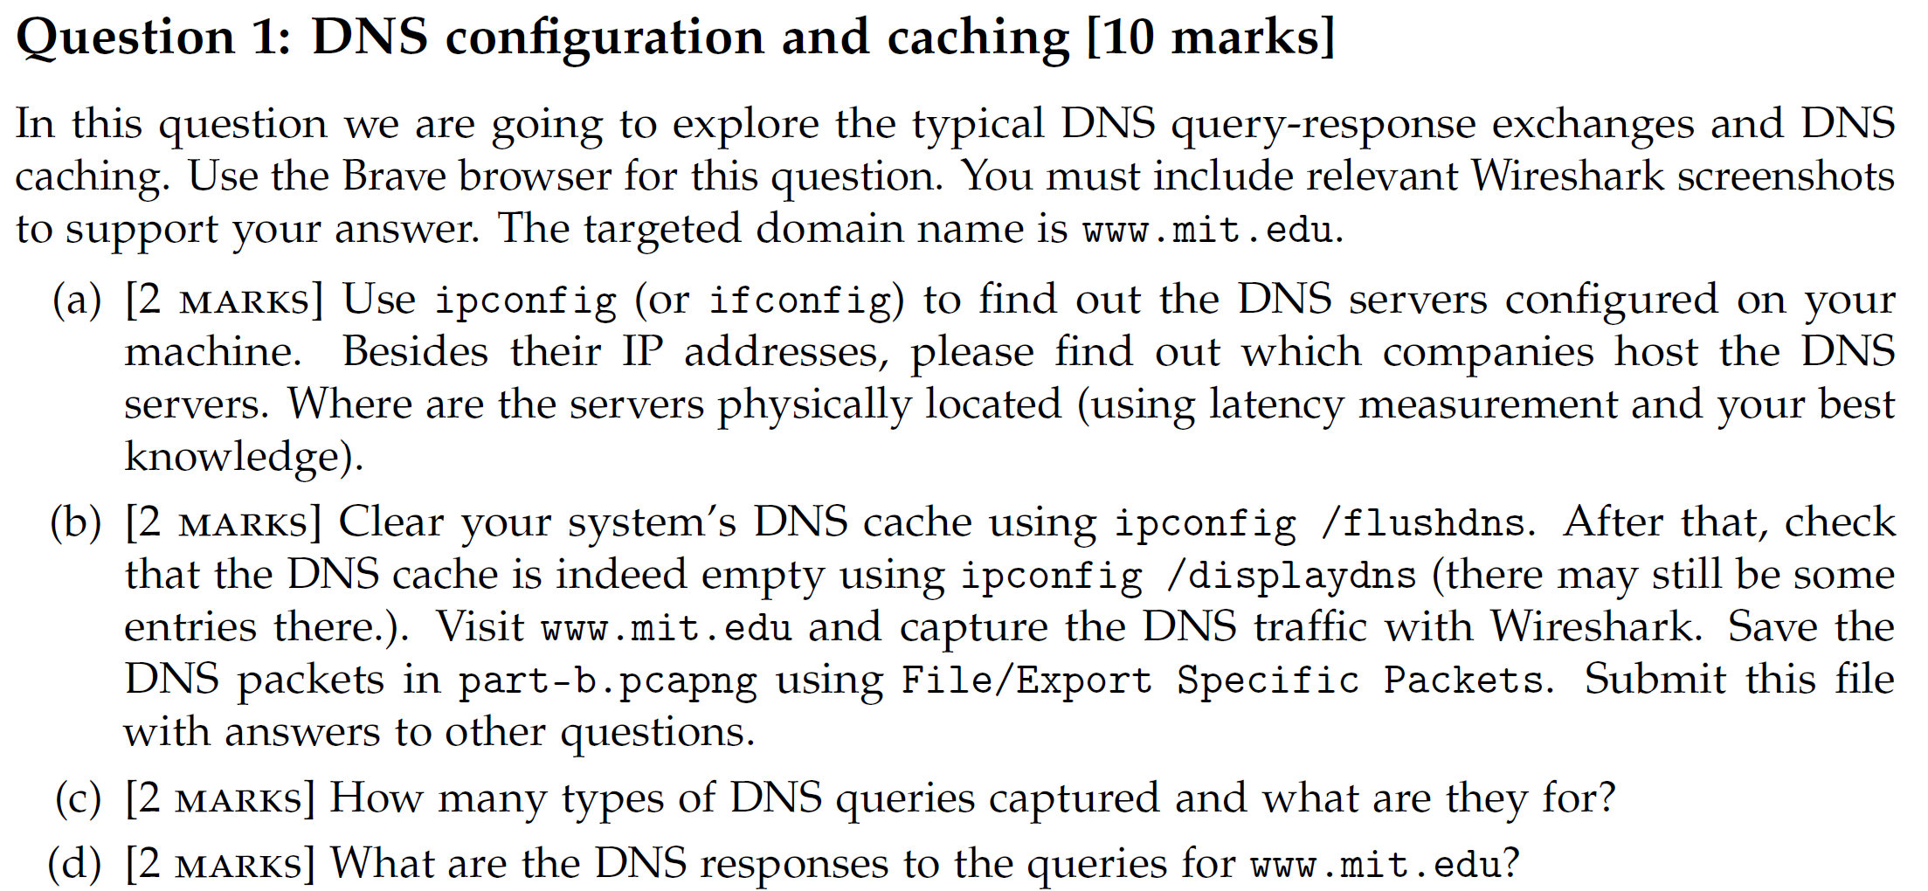

Slide 3
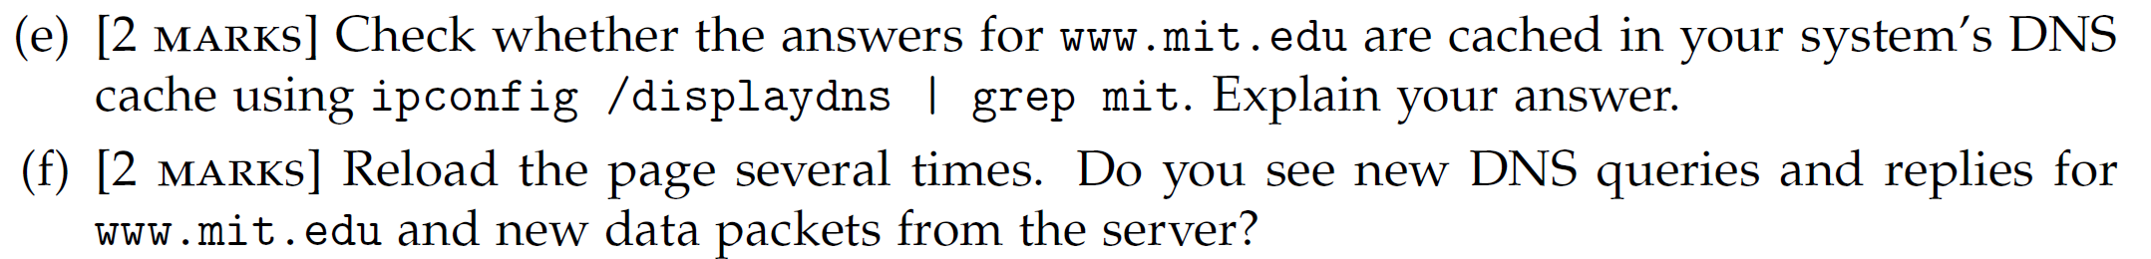

Slide 4
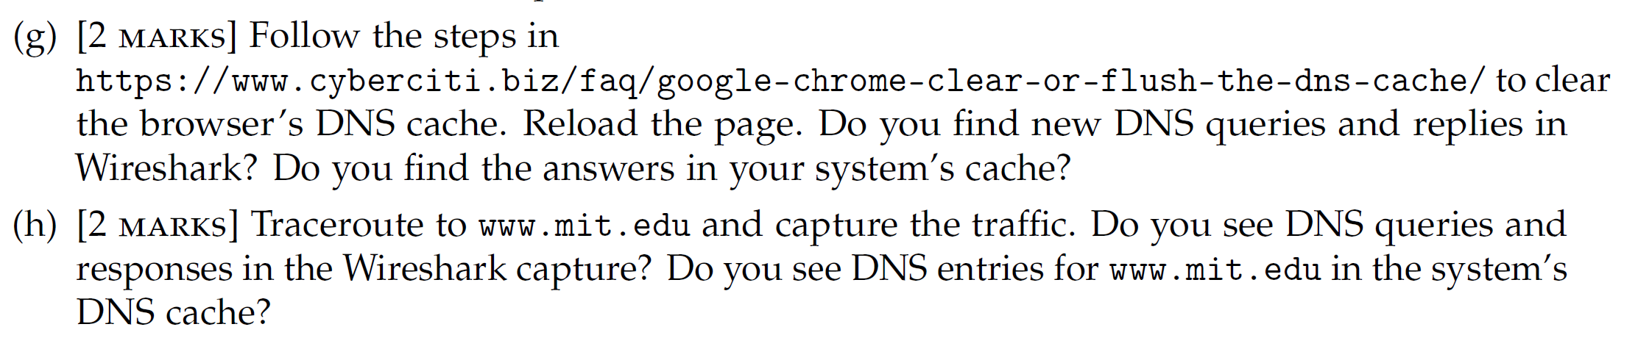

Slide 5
